Slide 1
CUSTOMER RETENTION DATASET
BY:-
RISHABH JOHRI
DATA SCIENCE-INTERN

Slide 2
Problem Statement:-
Customer satisfaction has emerged as one of the most important factors that guarantee the success of online store;
The main problem of the study is: Are customers satisfied by the services provided by the cell phone service providers or not?
A comprehensive review of the literature, theories and models have been carried out to propose the models for customer activation and customer retention.

Slide 3
Exploratory data analysis:-
1.Checking the Missing Values.
2.Checking for Numerical Columns.
3.Checking for the distribution of Numerical Variables.
4.Checking for Categorical Variables.
5.Types of Categorical Variables.

Slide 4
1.Checking the missing value:-
In this, the Missing value can be checked by the following python code
Missingvalue=[feature for feature in df.columns if data[feature].isnull().sum()>1]
Missingvalue(For printing records)
Observation:- There are no missing values present in the dataset

Slide 5
2. Checking the Numerical Columns:-
Numerical values can be checked using the following python code:-
NumericalFeature=[feature for feature in data.columns if data[feature].dtypes!="O"]
data[NumericalFeature]
Observation:- There are 1 numerical values present in the dataset.

Slide 6
3.Checking the categorical variable:-
Categorical variable can be checked using the below code:-
discreteFeature=[feature for feature in data.columns if feature not in NumericalFeature]
data[discreteFeature]
Observation:-
There are 70 categorical values present in dataset

Slide 7
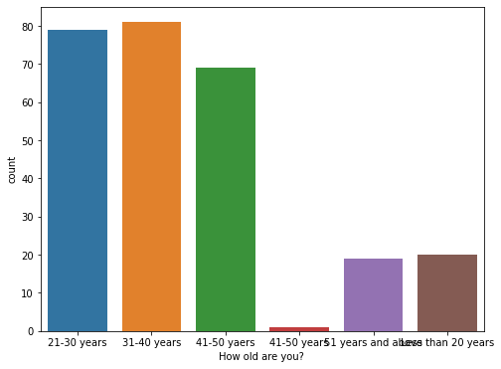
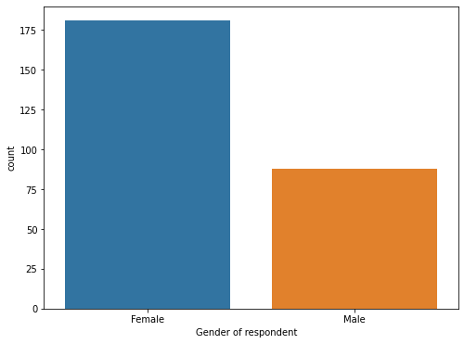
Data visualization:-
Observations:-
There are 81 peoples in age between 31 and 40 years. There are 70 peoples in the age between 41 and 50 years . There are 20 peoples in less than 20 years criteria. There are 19 peoples in 51 years and above criteria.
Observations:- There are 181 females and 88 Males.

Slide 8
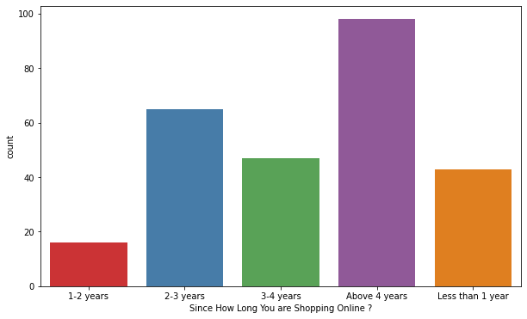
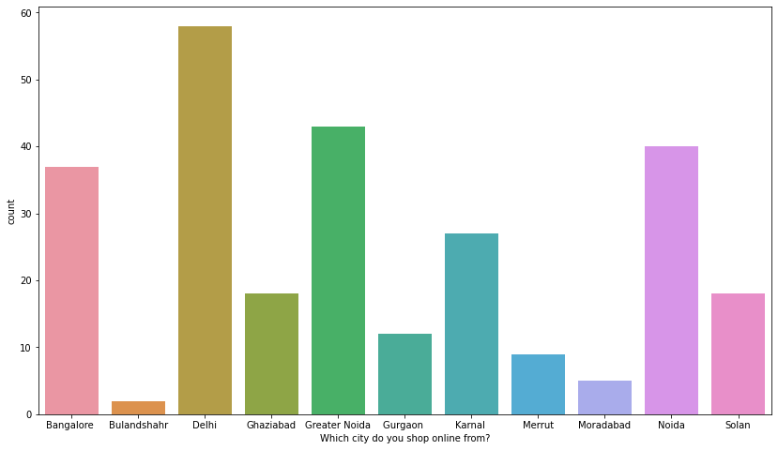
VISUALIZATIONS:-
Observations:-
1. There are 98 people are shopping online above 4 years 2. There are 65 people are shopping online between 2 and 3 years 3. There are 47 peples are shopping online between 3 and 4 years 4. There are 43 peoples are shopping online less than 1 year 5. There are 16 peoples are shopping online in between 1 and 2 years
Observations:-
1. 58 people shop online from Delhi. 2. 43 people shop online from Greater Noida 3.40 people shop online from Noida 4. 37 People shop online from Noida 5.27 People shop online from Karnal Area. 6.12 People shop online from Gurgaon 7.9 People shop online from Meerut 8. 5 People shop online from Moradabad 9. 2 People shop online from Bulandshehar. 10. 18 people shop online from Ghaziabad.

Slide 9
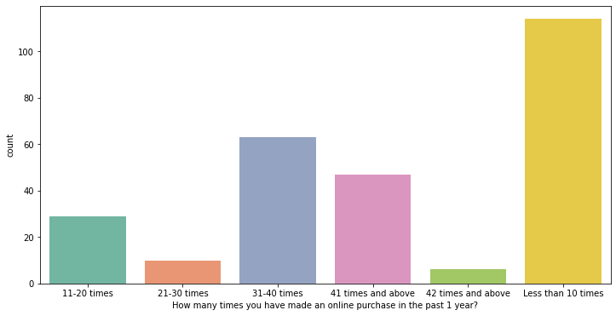
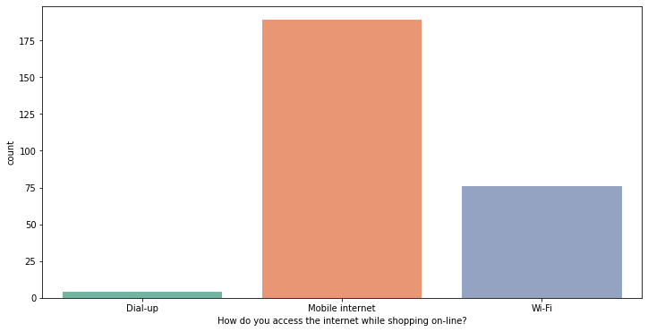
How many times you have made an online purchase in the past 1 year?
How do you access the internet while shopping on-line?
Observations:-
1. There are 114 people have made online purchase less than 10 times. 2. There are 63 peoples have made online purchase in between 31 and 40 times. 3. There are 47 peoples have made online purchase 41 times and above. 4. There are 29 peoples have made online purchase 11-20 times. 5.There are 10 peoples have made online purchase 21-30 times. 6. there are 6 peoples have made online purchase 42 times and above.
Observations:-
1.There are 189 people accessing the mobile internet. 2. There are 76 people accessing the WiFi network . 3. There are 4 people accessing the Dial-up network.

Slide 10
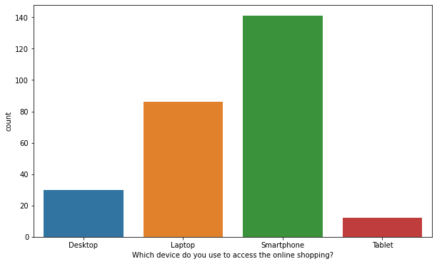
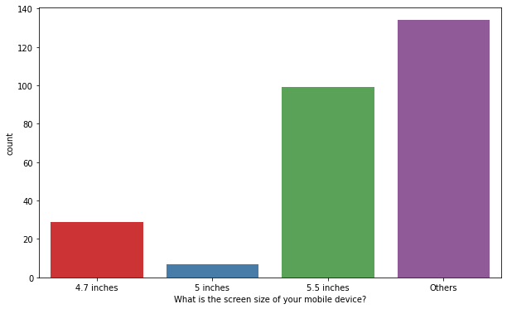
Observations:-
1.There are 189 people accessing the mobile internet.
2.There are 76 people accessing the WiFi network.
3.There are 4 people accessing the Dial-up network.
Observations:-
1. 141 people use smart phone to access the shopping online
2. 86 people use laptop for accessing the shopping online
3. 30 people use desktop for accessing the shopping online.
4. 12 people use tablet for accessing the shopping online.

Slide 11
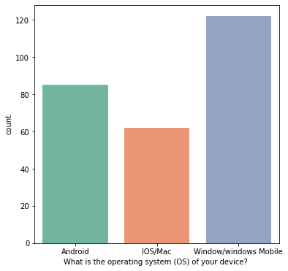
Observations:-
1. The screen size of Mobile device of the people shopping online of 5.5 inches are 99.
2. The screen size of Mobile device of the people shopping online of 4.7 inches are 29.
3. The screen size of Mobile device of the people shopping online of 5 inches are 7.
4. The screen size of Mobile device of the people shopping online of others are 134.
Observations:-
1. The operating system used by people who are shopping online in windows/ windows Mobile are 122.
2. The operating system used by people who are shopping online in Android are 85.
3. The operating system used by people who are shopping online in IOS/MAC are 62.

Slide 12
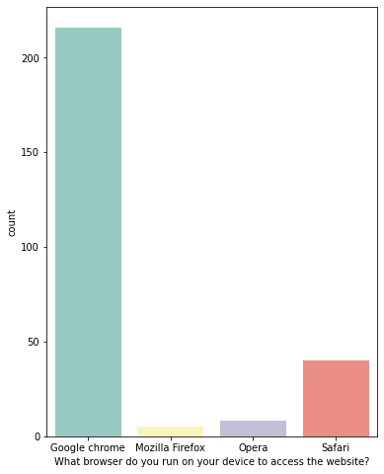
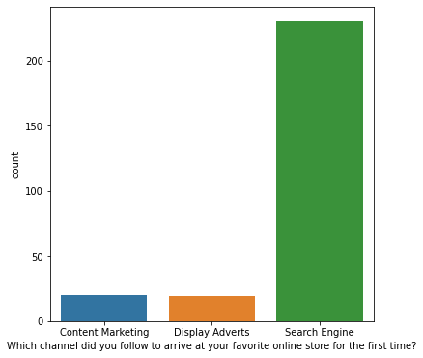
Observations:-
1. The Browser used by people in the device to access the website in Google Chrome are 216.
2. The browser used by people in the device to access the website in safari are 40.
3. The browser used by people in the device to access the website in opera are 8.
4. The browser used by people in the device to access the website in Mozilla FireFox are 5.
Observation:-
1.There are 230 people who follow the search engine channel to arrive at your favourite online store for the first time.
2.There are 20 people who follow the content marketing channel to arrive at your favourite online store for the first time.
3.There are 19 people who follow the Display Adverts to arrive at your favourite online store for the first time.

Slide 13
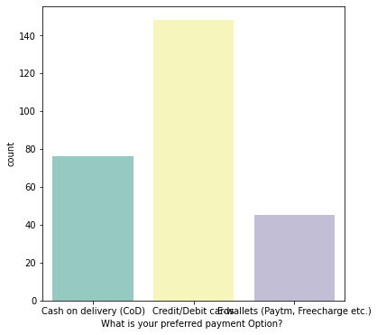
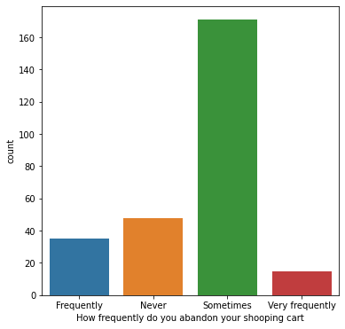
Observations:-
1. The number of people who preferred payment location as credit/debit cards are 148.
2.The number of people who preferred payment location as cash on delivery are 76.
3.The number of people who preferred payment location as E-wallets(Paytm, Free charge etc) cards are 45.
Observations:-
1.The people abandon on the shopping cart sometimes are 171
2.The people never abandon on the shopping cart are 48
3.The people abandon on the shopping cart frequently are 35
4.The people abandon on the shopping cart very Frequently are 15.

Slide 14
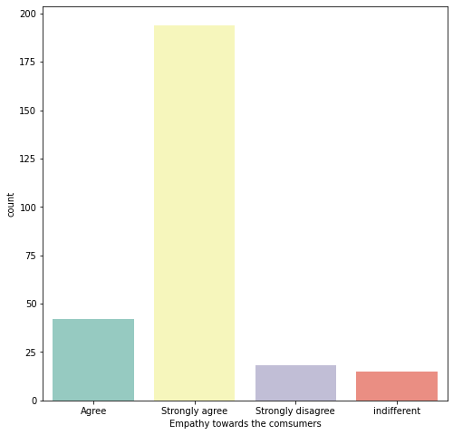
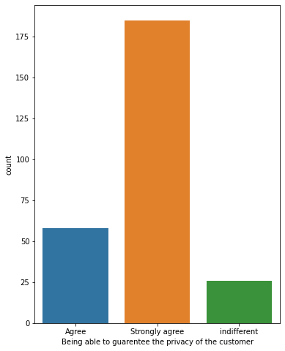
Observations:-
1. People who strongly agree on empathy towards the consumer are 194.
2.People who agree on empathy towards the consumer are 42
3.People who strongly disagree on empathy towards the consumer are 18.
4.people who are indifferent on empathy towards the consumer are 15.
Observations:-
1.People who are strongly agree on being able to guarantee the privacy of the customer are 185.
2.People who agree on being able to guarantee the privacy of the customer are 58.
3.People who are indifferent on being able to guarantee the privacy of the customer are 26.

Slide 15
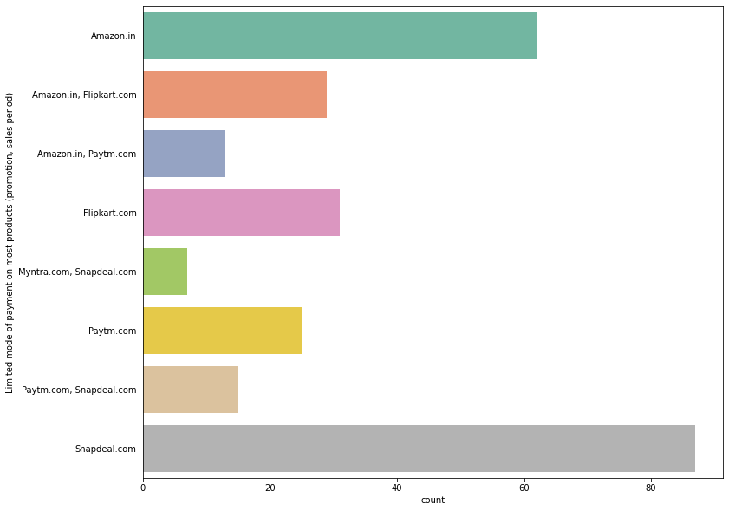
SOME MORE CATEGORICAL VISUALISATIONS:-
Observations:-
1. Limited mode of payment on most products (promotion, sales period) on Snapdeal.com are 87
2. Limited mode of payment on most products (promotion, sales period) on Amazon.in are 62
3.Limited mode of payment on most products (promotion, sales period) on Flipkart.com are 31
4.Limited mode of payment on most products (promotion, sales period) on Amazon.in, Flipkart.com are 29
5.Limited mode of payment on most products (promotion, sales period) on paytm.com are 25
6. Limited mode of payment on most products (promotion, sales period) on Paytm.com, Snapdeal.com are 15
7. Limited mode of payment on most products (promotion, sales period) on Amazon.in, Paytm.com are 13
8. Limited mode of payment on most products (promotion, sales period) on Myntra.com, Snapdeal.com are 7

Slide 16
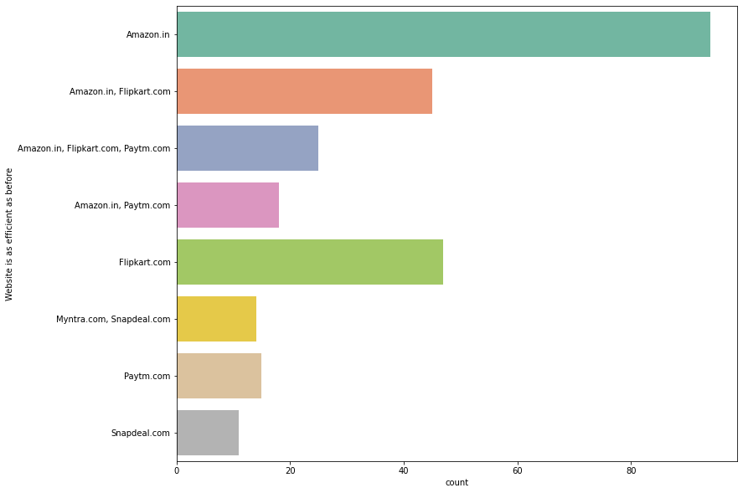
Observation:-
1.Website is as efficient as before in Amazon.in for 94 people.
2.Website is as efficient as before in Flipkart.com for 47 people.
3.Website is as efficient as before in Amazon.in, Flipkart.com for 45 people.
4.Website is as efficient as before in Amazon.in, Flipkart.com, Paytm.com for 25 people.
5.Website is as efficient as before in Amazon.in, Paytm.com for 18 people.
6.Website is as efficient as before in Paytm.com for 15 people.
7.Website is as efficient as before in amazon.in, Paytm.com for 18 people.
8.Website is as efficient as before in Paytm.com for 15 people.
9.Website is as efficient as before in Paytm.com for 15 people.
10. Website is as efficient as before in Myntra.com, Snapdeal.com for 14 people.
11.Website is as efficient as before in Snapdeal.com for 11 people.

Slide 17
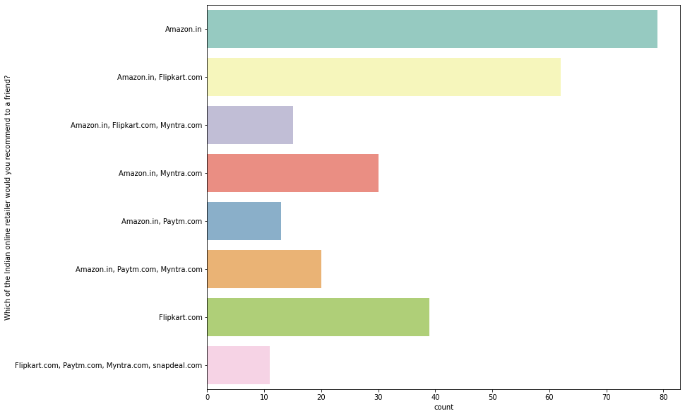
Observation:-
1.The Indian online retailer would you recommend to a friend by people in Amazon.in are 79.
2. The Indian online retailer would you recommend to a friend by people in Amazon.in, Flipkart.com are 39.
3.The Indian online retailer would you recommend to a friend by people in Amazon.in, Flipkart.com are 62.
4.The Indian online retailer would you recommend to a friend by people in Flipkart.com are 39.
5.The Indian online retailer would you recommend to a friend by people in Amazon.in, Myntra.com are 30.
6.The Indian online retailer would you recommend to a friend by people in Amazon.in, Paytm.com, Myntra.com are 20.
7.The Indian online retailer would you recommend to a friend by people in Amazon.in, Flipkart.com, Myntra.com are 15.
8.The Indian online retailer would you recommend to a friend by people in Amazon.in, Paytm.com are 13.
9.The Indian online retailer would you recommend to a friend by people in Flipkart.com, Paytm.com, Myntra.com, Snapdeal.com are 11.

Slide 18
SOME MORE EDA STEPS WHICH HAS BEEN PERFORMED :-
1. For checking the rows and columns present in the dataset
Data.shape
2. For Checking the null values in the dataset:-
Command used:- data.isnull().sum()
3. For checking the statistical summary of dataset:
Command used:- data,describe()
4. For checking the available columns in the dataset:
Command used:- data.columns

Slide 19
CONCLUSION OF THE FINDINGS:-
So, as per the findings during the EDA Phase:-
The Customer satisfaction has emerged as one of the most important factors that guarantee the success of online store, it has been posited as a key stimulant of purchase, repurchase intentions and customer loyalty. A comprehensive review of the literature, theories and models have been carried out to propose the models for customer activation and customer retention. Five major factors that contributed to the success of an e-commerce store have been identified as: service quality, system quality, information quality, trust and net benefit. The research furthermore investigated the factors that influence the online customers repeat purchase intention. The data is collected from the Indian online shoppers. Results indicate the e-retail success factors, which are very much essential for customer satisfaction.

Slide 20
THANK YOU

